Slide 1

Deep Observation of Fast-Detrapping Model
&
Development to Region Split Model
20240531
진명
1/16
School of Electrical Engineering, Seoul National University

Slide 2

QnA with 김민수 박사
주요사항
Barrier lowering 관련 질문 – 이번 발표에서 다룰 예정
논문에서의 figure 추출 방법
- 우선, 논문에 있는 그대로의 model 식으로 figure 구성.
활용했던 figure 추출 자료 (TCAD 및 model) 없음
(Figure가 틀렸을 때, 1대1 비교 대상이 없는 상황)
2/16
School of Electrical Engineering, Seoul National University

Slide 3

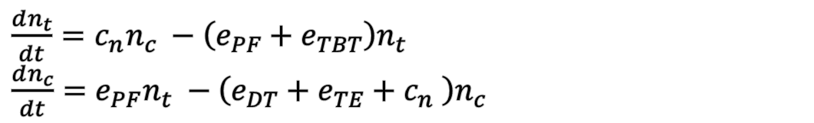

Model Observation
BETOX
Conduction Band
CTN
Conduction Band
DT+TE
PF
Field
Channel
Field
CTN
Trap Site
$ΔV_{t} =1 V$
TBT
Capture
BETOX
Trap Site
$≈4.3×{10}^{18} \left[cm^{−3}\right]$
Detrap Modeling
Field Dependency induced by CTN
$\frac{dn_{t}}{dt}=c_{n}n_{c} −\left(e_{PF}+e_{TBT}\right)n_{t}$
$\frac{dn_{c}}{dt}=e_{PF}n_{t} −\left(e_{DT}+e_{TE}+c_{n} \right)n_{c}$
3/16
School of Electrical Engineering, Seoul National University

Slide 4

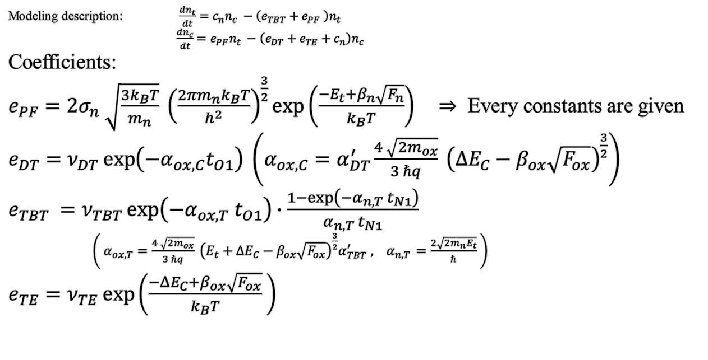
Field Dependency
Modeling description: $\frac{dn_{t}}{dt}=c_{n}n_{c} −\left(e_{TBT}+e_{PF} \right)n_{t}$
$\frac{dn_{c}}{dt}=e_{PF}n_{t} −\left(e_{DT}+e_{TE}+c_{n}\right)n_{c}$
Coefficients:
$e_{PF}=2σ_{n} \sqrt{\frac{3k_{B}T}{m_{n}}} {\left(\frac{2πm_{n}k_{B}T}{h^{2}}\right)}^{\frac{3}{2}}\exp\left(\frac{−E_{t}+β_{n}\sqrt{F_{n}}}{k_{B}T}\right) ⇒$ Every constants are given
$e_{DT}=ν_{DT}\exp\left(−α_{ox,C}t_{O1}\right) \left(α_{ox,C}=α_{DT}^{′}\frac{4 \sqrt{2m_{ox}}}{3 ℏq} {\left(ΔE_{C}−β_{ox}\sqrt{F_{ox}}\right)}^{\frac{3}{2}}\right)$
$e_{TBT} =ν_{TBT}\exp\left(−α_{ox,T} t_{O1}\right)∙\frac{1−\exp\left(−α_{n,T} t_{N1}\right)}{α_{n,T} t_{N1}}$
$\left( α_{ox,T}=\frac{4 \sqrt{2m_{ox}}}{3 ℏq} {\left(E_{t}+ΔE_{C}−β_{ox}\sqrt{F_{ox}}\right)}^{\frac{3}{2}}α_{TBT}^{′} , { α}_{n,T }=\frac{2\sqrt{2m_{n}E_{t}}}{ℏ} \right)$
$e_{TE}=ν_{TE}\exp\left(\frac{−{ΔE}_{C}+β_{ox}\sqrt{F_{ox}}}{k_{B}T} \right)$
Field
Field
20240705 수정
Field
: Barrier lowering with field dependency
Field
Field
4/16
School of Electrical Engineering, Seoul National University

Slide 5
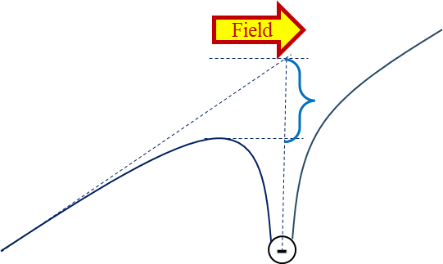
Barrier Lowering
Barrier lowering term : $−β\sqrt{F}$ ($β=\sqrt{\frac{q^{3}}{πε}}$ , F = 전기장)
Field
Field
Field
1.
Barrier height lowering
-
Field
Field
Field
2.
Tunneling length shortening
BE-Tox Barrier Lowering
5/16
School of Electrical Engineering, Seoul National University

Slide 6
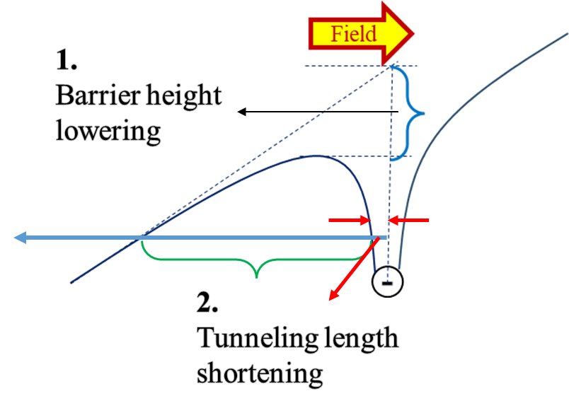
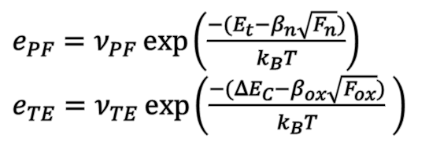
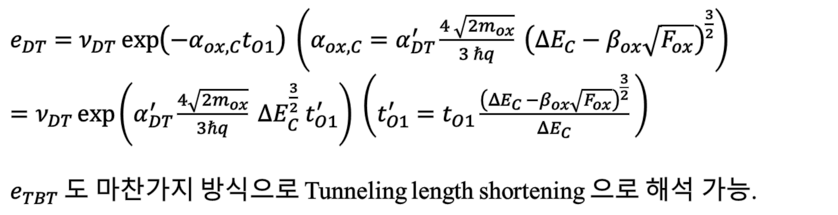
Barrier Lowering
1. Barrier height lowering : PF, TE
$e_{PF}=ν_{PF}\exp\left(\frac{−{(E}_{t}−β_{n}\sqrt{F_{n}})}{k_{B}T}\right)$
$e_{TE}=ν_{TE}\exp\left(\frac{−{(ΔE}_{C}−β_{ox}\sqrt{F_{ox}})}{k_{B}T} \right)$
20240705 수정
김민수 박사의 답변
2. Tunneling length shortening : DT, TBT
$e_{DT}=ν_{DT}\exp\left(−α_{ox,C}t_{O1}\right) \left(α_{ox,C}=α_{DT}^{′}\frac{4 \sqrt{2m_{ox}}}{3 ℏq} {\left(ΔE_{C}−β_{ox}\sqrt{F_{ox}}\right)}^{\frac{3}{2}}\right)$
$=ν_{DT}\exp\left(α_{DT}^{′}\frac{4\sqrt{2m_{ox}}}{3ℏq} ΔE_{C}^{\frac{3}{2}} t_{O1}^{′}\right) \left(t_{O1}^{′}=t_{O1}\frac{{\left(ΔE_{C} −β_{ox}\sqrt{F_{ox}}\right)}^{\frac{3}{2}}}{ΔE_{C}} \right)$
$e_{TBT}$도 마찬가지 방식으로 Tunneling length shortening 으로 해석 가능.
Effective한 tunneling length 가 줄어듦
6/16
School of Electrical Engineering, Seoul National University

Slide 7
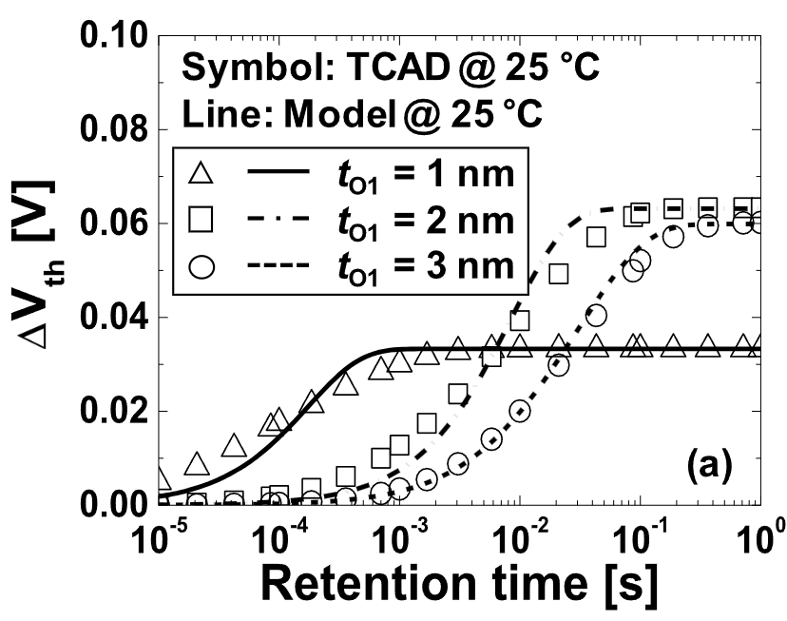
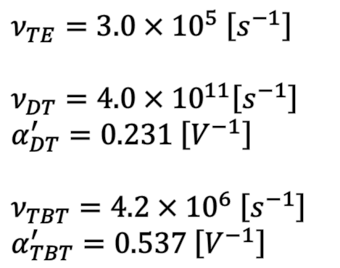
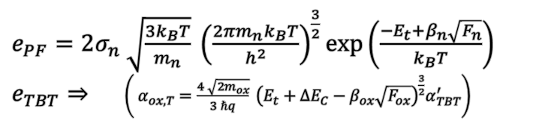
Result with using parameters in paper
①
$ν_{TE}=3.0×{10}^{5} \left[s^{−1}\right]$
$ν_{DT}=4.0×{10}^{11}\left[s^{−1}\right]$
$α_{DT}^{′}=0.231 \left[V^{−1}\right]$
$ν_{TBT}=4.2×{10}^{6} \left[s^{−1}\right]$
$α_{TBT}^{′}=0.537 \left[V^{−1}\right]$
=> Parameter을 있는 그대로 활용하면 tau값이 너무 작게 나옴.
②
$e_{PF}=2σ_{n} \sqrt{\frac{3k_{B}T}{m_{n}}} {\left(\frac{2πm_{n}k_{B}T}{h^{2}}\right)}^{\frac{3}{2}}\exp\left(\frac{−E_{t}+β_{n}\sqrt{F_{n}}}{k_{B}T}\right)$
$e_{TBT}⇒$ $\left( α_{ox,T}=\frac{4 \sqrt{2m_{ox}}}{3 ℏq} {\left(E_{t}+ΔE_{C}−β_{ox}\sqrt{F_{ox}}\right)}^{\frac{3}{2}}α_{TBT}^{′}\right)$
=> TBT와 PF의 barrier lowering을 없애면 논문의 figure와 정확히 일치함.
7/16
School of Electrical Engineering, Seoul National University

Slide 8
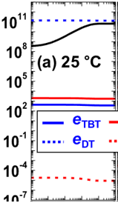
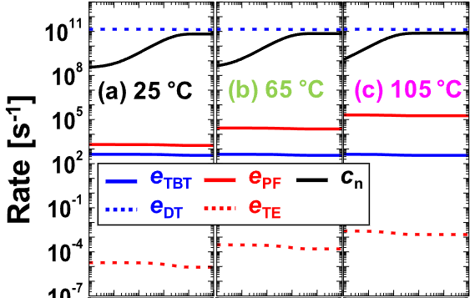
Result with using parameters in paper
Given parameters
① 과 같이 세부 parameter가 모두 맞아도 emission/capture rate관련 계수들이 맞지 않음.
①
Modified barrier lowering
②와 같이 ΔVt가 맞아도 세부적인 emission/capture rate관련 계수들이 맞지 않음.
②
8/16
School of Electrical Engineering, Seoul National University

Slide 9
Result with using parameters in paper
>> Not matching!
Cross Check)
반대로 emission/capture rate 관련 계수들을 맞추어도 ΔVt response가 맞지 않음.
9/16
School of Electrical Engineering, Seoul National University

Slide 10

Characteristics about Parameter Variation
Temperature variation
Trap level variation
$α_{oxT}$ variation
해당 모델은 stretched exponential 형태에서 shape parameter β에는 영향을 주지 못하고, 오직 τ값에 fitting이 목적임.
Result of Fast-detrapping Model matching
>> Model에 대하여 exact parameter을 대입하였을 땐 논문 figure 와 mismatch.
>> 소폭의 parameter 변화 만으로도 τ값의 변화가 큰 model임을 보임.
10/16
School of Electrical Engineering, Seoul National University

Slide 11

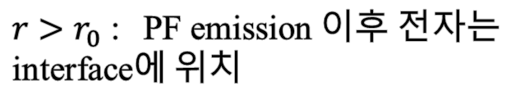
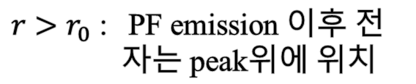

Development: Region Split Model
Poole-Frenkel Emission along thick layer
Poole-Frenkel Emission along thin layer
(interface region)
$$r$$
$r_{0}= \sqrt{\frac{q}{4πεF}}$
$r>r_{0}$ : PF emission 이후 전 자는 peak위에 위치
$r>r_{0}$ : PF emission 이후 전자는 interface에 위치
11/16
School of Electrical Engineering, Seoul National University

Slide 12
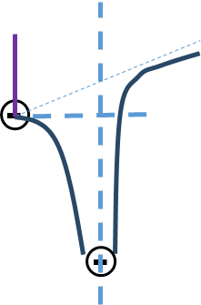
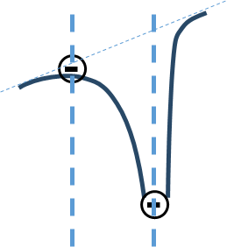

Development: Region Split Model
Interface
(BETOX/Channel)
$r_{0}= \sqrt{\frac{q}{4πεF}}$
$$r_{0}$$
DT+TE
BETOX
Conduction Band
DT+TE
PF
Field
Channel
PF
PF
Field
Channel
Field
TBT
Capture
Field
BETOX
Trap Site
TBT
Capture
$$r_{0}$$
DT+TE
Capture
PF
PF
TBT
12/16
School of Electrical Engineering, Seoul National University

Slide 13
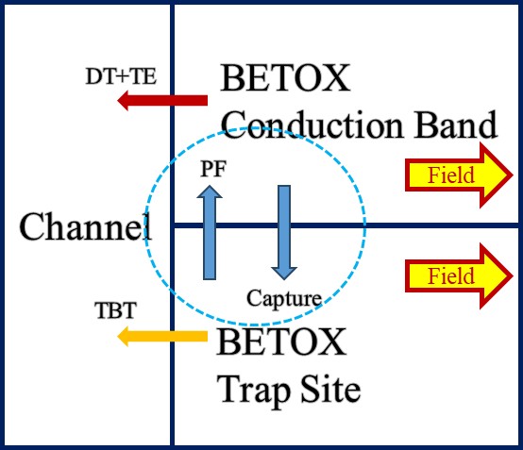
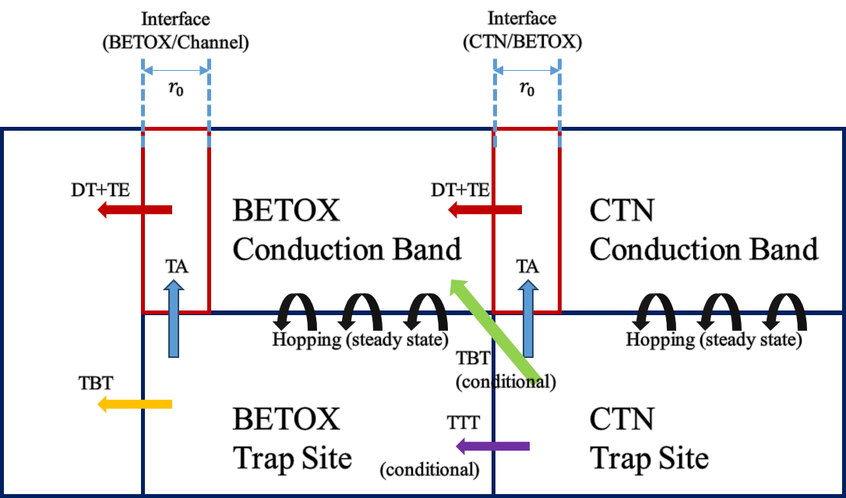
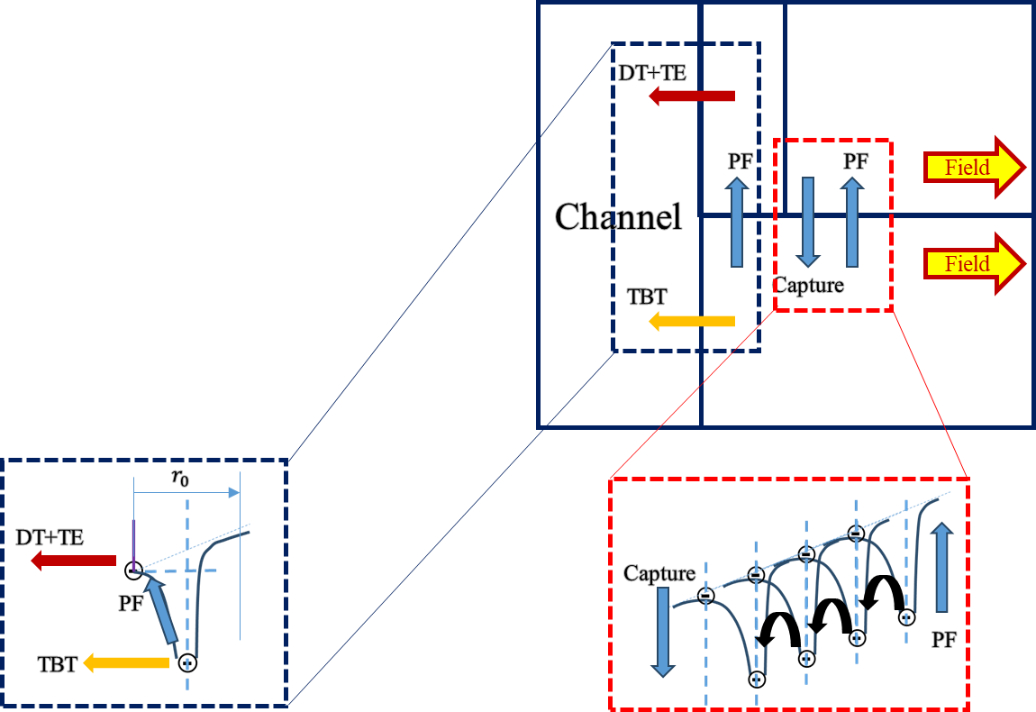
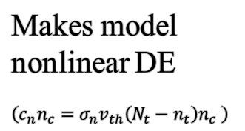
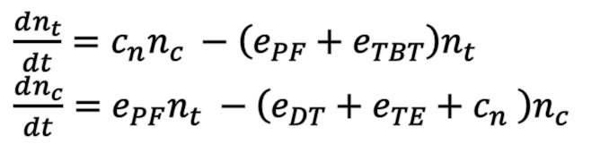
Development: Region Split Model
$\frac{dn_{t}}{dt}=c_{n}n_{c} −\left(e_{PF}+e_{TBT}\right)n_{t}$
$\frac{dn_{c}}{dt}=e_{PF}n_{t} −\left(e_{DT}+e_{TE}+c_{n} \right)n_{c}$
Makes model nonlinear DE
$\left(c_{n}n_{c}=σ_{n}v_{th}\left(N_{t}−n_{t}\right)n_{c} \right)$
Expand to CTN
Region split model => Steady-state model
13/16
School of Electrical Engineering, Seoul National University

Slide 14
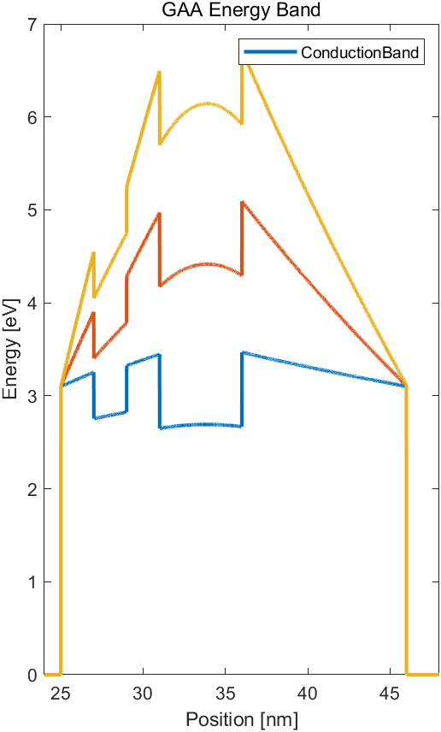

Development: Region Split Model
TBT
4.3e19
2.4e19
TBT
0.43e19
Conditionally no TBT
(conditional) 부분의 의미 :
>> PV level, Energy band의 상황에 따라 CTN trap / BETOX의 전자의 움직임이 달라짐
14/16
School of Electrical Engineering, Seoul National University

Slide 15
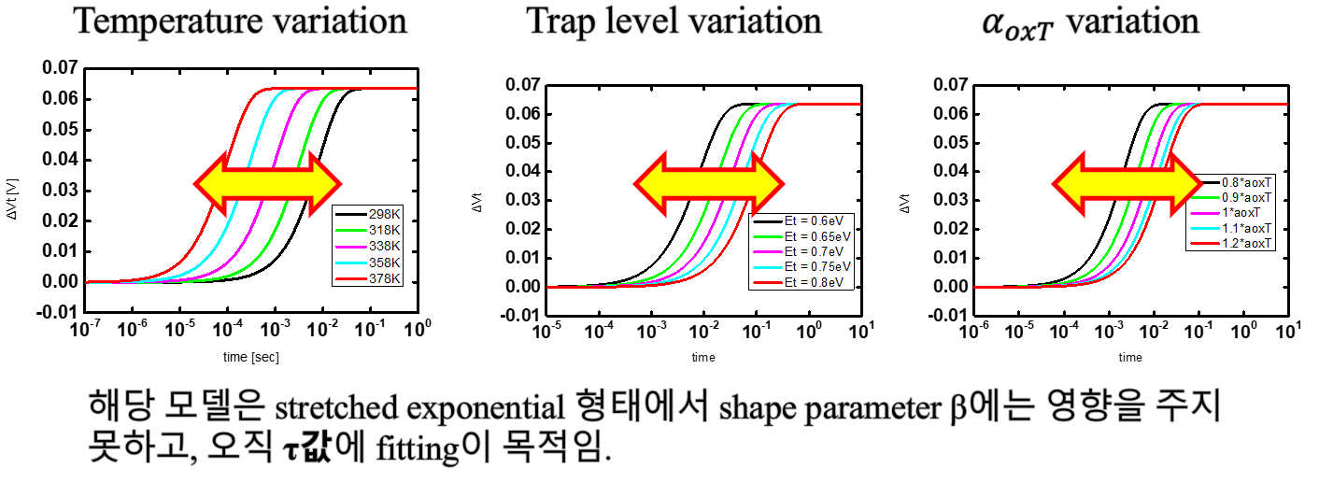
Development: Region Split Model
Why steady-state model is important?
(page 10)…
If steady-state model is valid…
Stretch exponential 의 shaping parameter β 에 해당하는 modeling 가능할 것으로 예상.
15/16
School of Electrical Engineering, Seoul National University

Slide 16
Future Works
Model Development
TAT region split model (steady-state)
TCAD Simulation
Simulation with various PV level & trap level
Show steady-state that can happen during retention state
16/16
School of Electrical Engineering, Seoul National University

